Slide 1
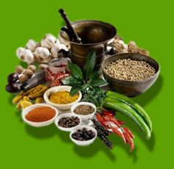
Project name: The Power Of Ancient Indian Medicines Sector: 3H Project code: HH14020 College: Government College Of Engineering Aurangabad Mentor: Sayali Pawar

Slide 2

Objectives: 1. Dream India Disease Free. 2. Create Awareness about The Power Of Ancient Indian Remedies. 3. Provide remedies for free and be supportive at Odd Times.

Slide 3

Focus: 1. Just by one click anybody can access remedies sitting at home at free of cost. 2. Even by using an Offline Android App, anyone can search for remedies without having internet facility. 3. Save money and be your own doctor.

Slide 4
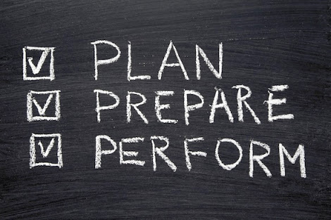
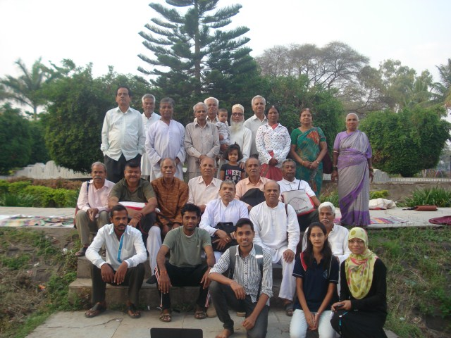
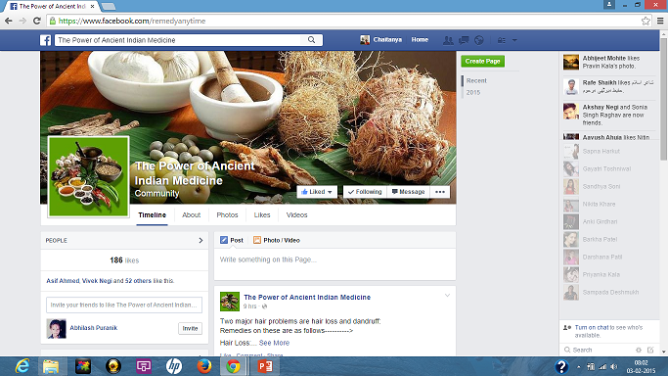
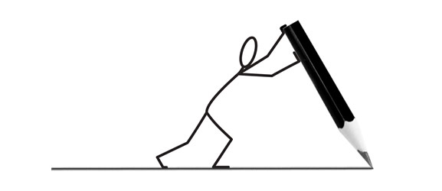

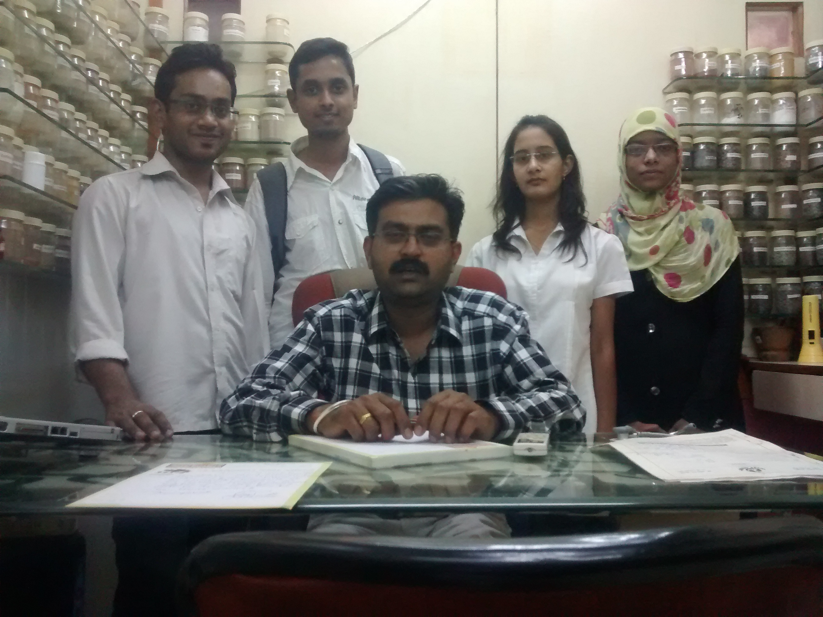
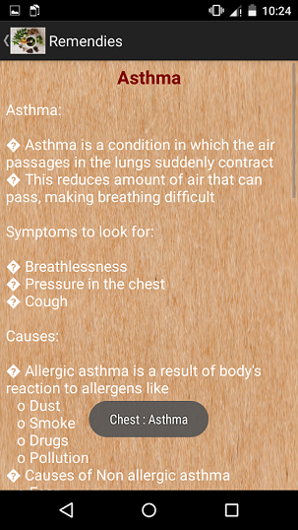
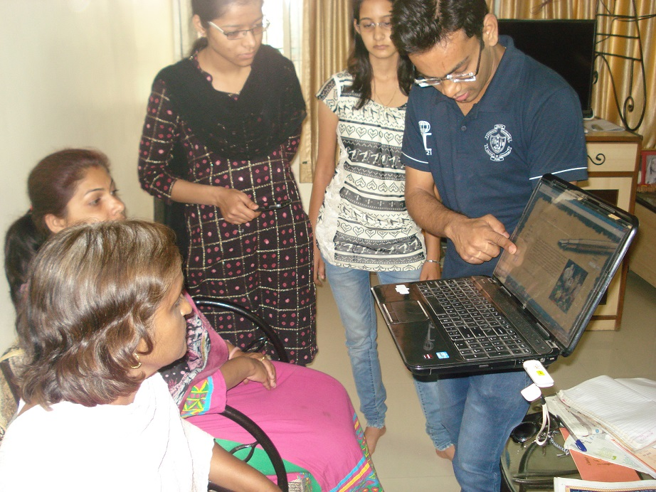
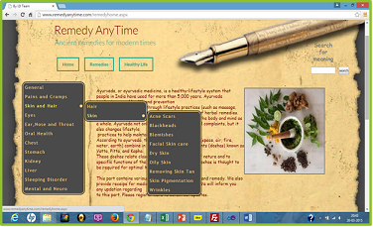
Work Done

Slide 5
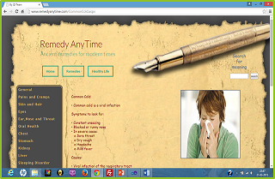
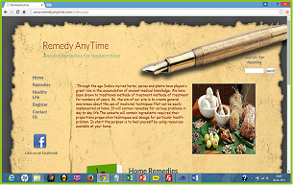
1.Website Hosted a website named “ www.remedyanytime.com ”
(Point to point Explanation)
(Introduction Page)
(Categorised Remedies)

Slide 6
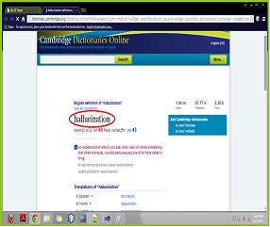
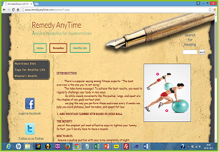
www.remedyanytime.com provides easy user-friendly interface.
(Dictionary) (Other than Remedies)

Slide 7
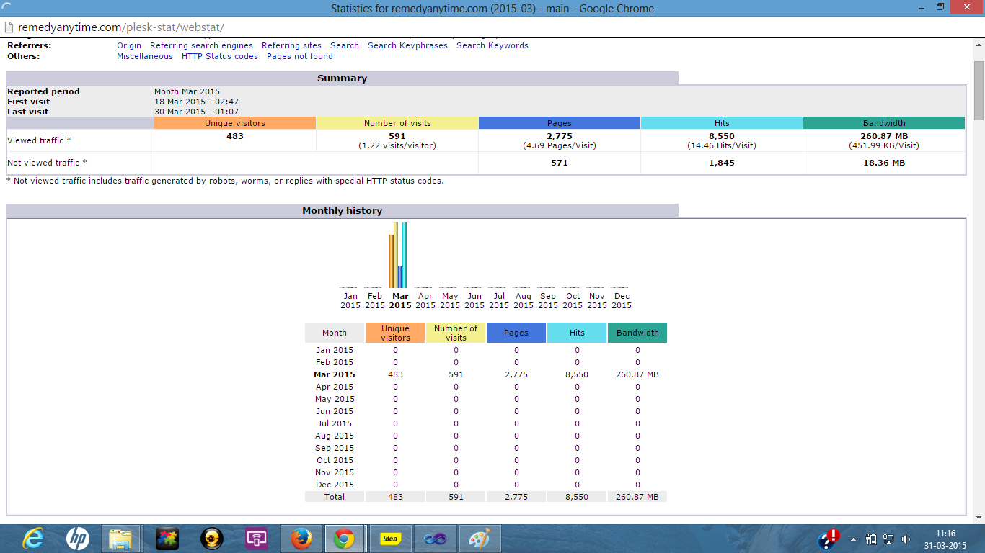
Statistics:
1.We got 483 unique users till
30th March,2015.
2.We got around 8500 hits on our website till date(nearly 14 hits per visit)
3.Data is collected from our Hosting service(GoDaddy).

Slide 8
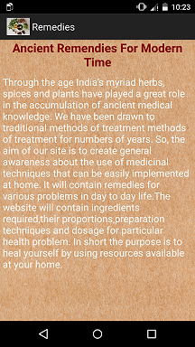
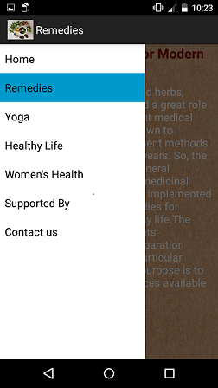
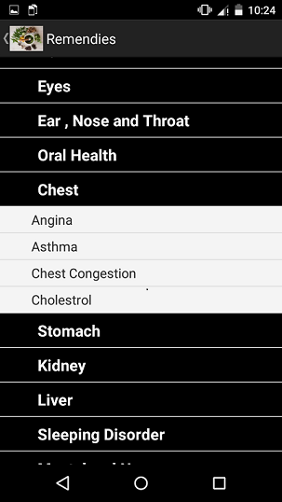
2.Android App Launched an Offline Android App for mobile users. This app added sustainability to our Project.

Slide 9

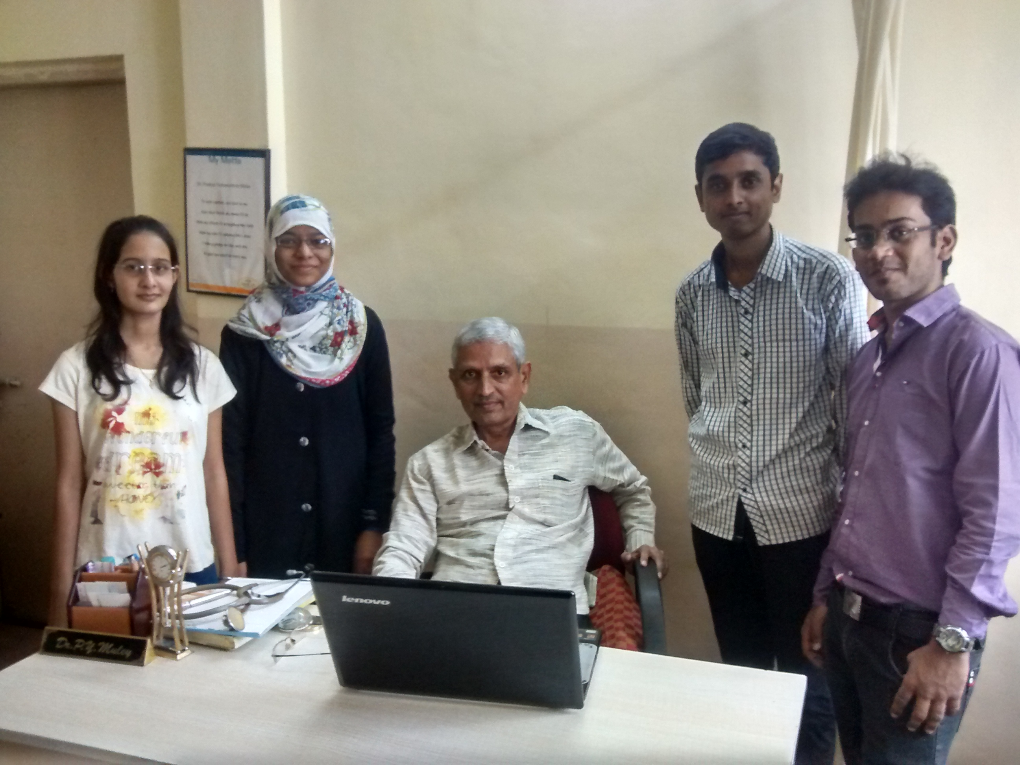
3.Guidance from Experts : Guidance from Dr. Ravindra Kharat and from Dr. Muley.
(With Dr. Ravindra Kharat) (With Dr. Muley)

Slide 10
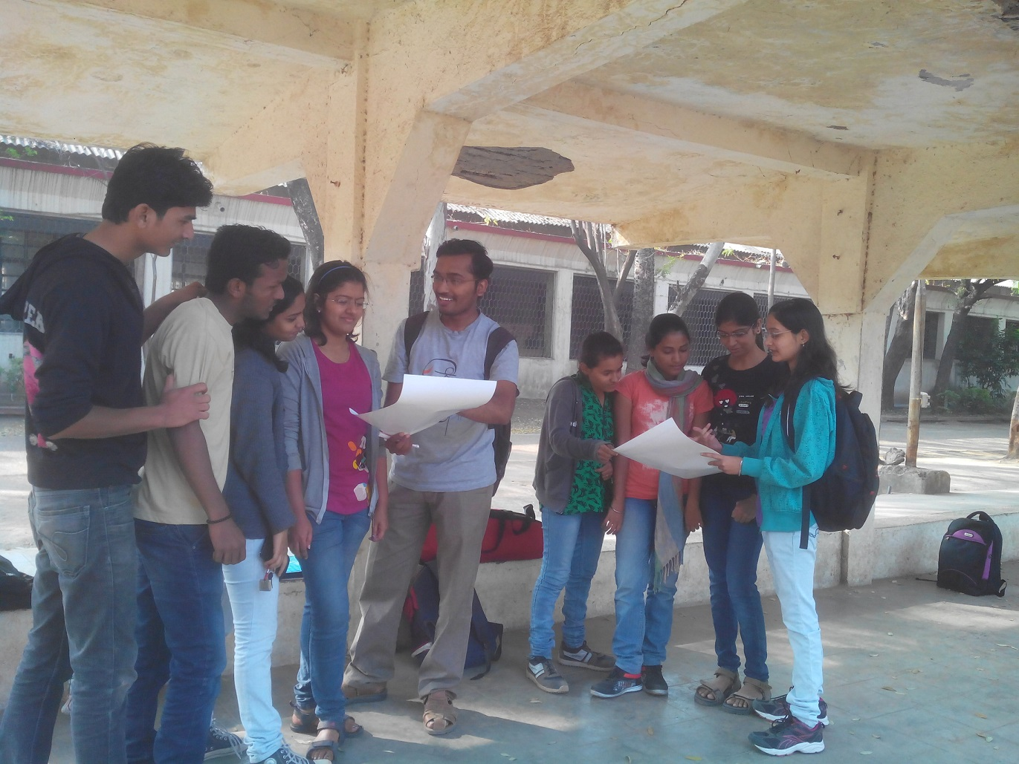
4.Awareness Campaign Initiated…. Initiated awareness about home remedies with the help of social networking sites like Facebook Awareness through face to face interaction in the colleges.
(Facebook Page) (Awareness in GECA campus)

Slide 11
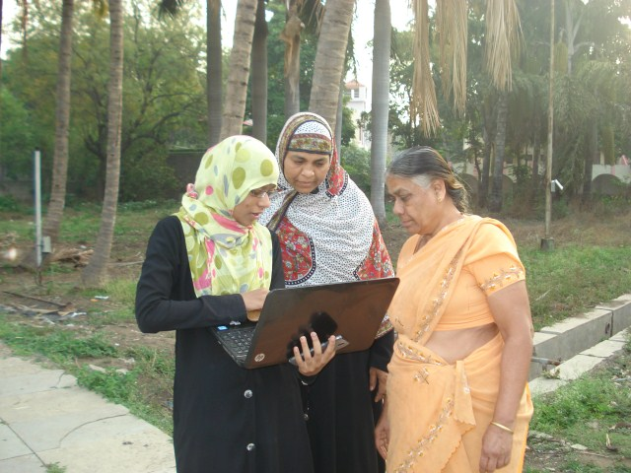
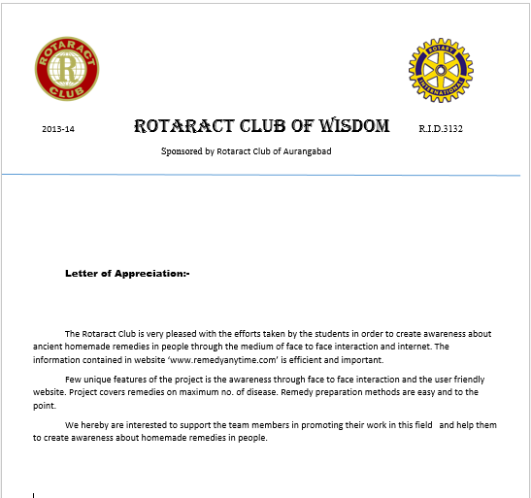
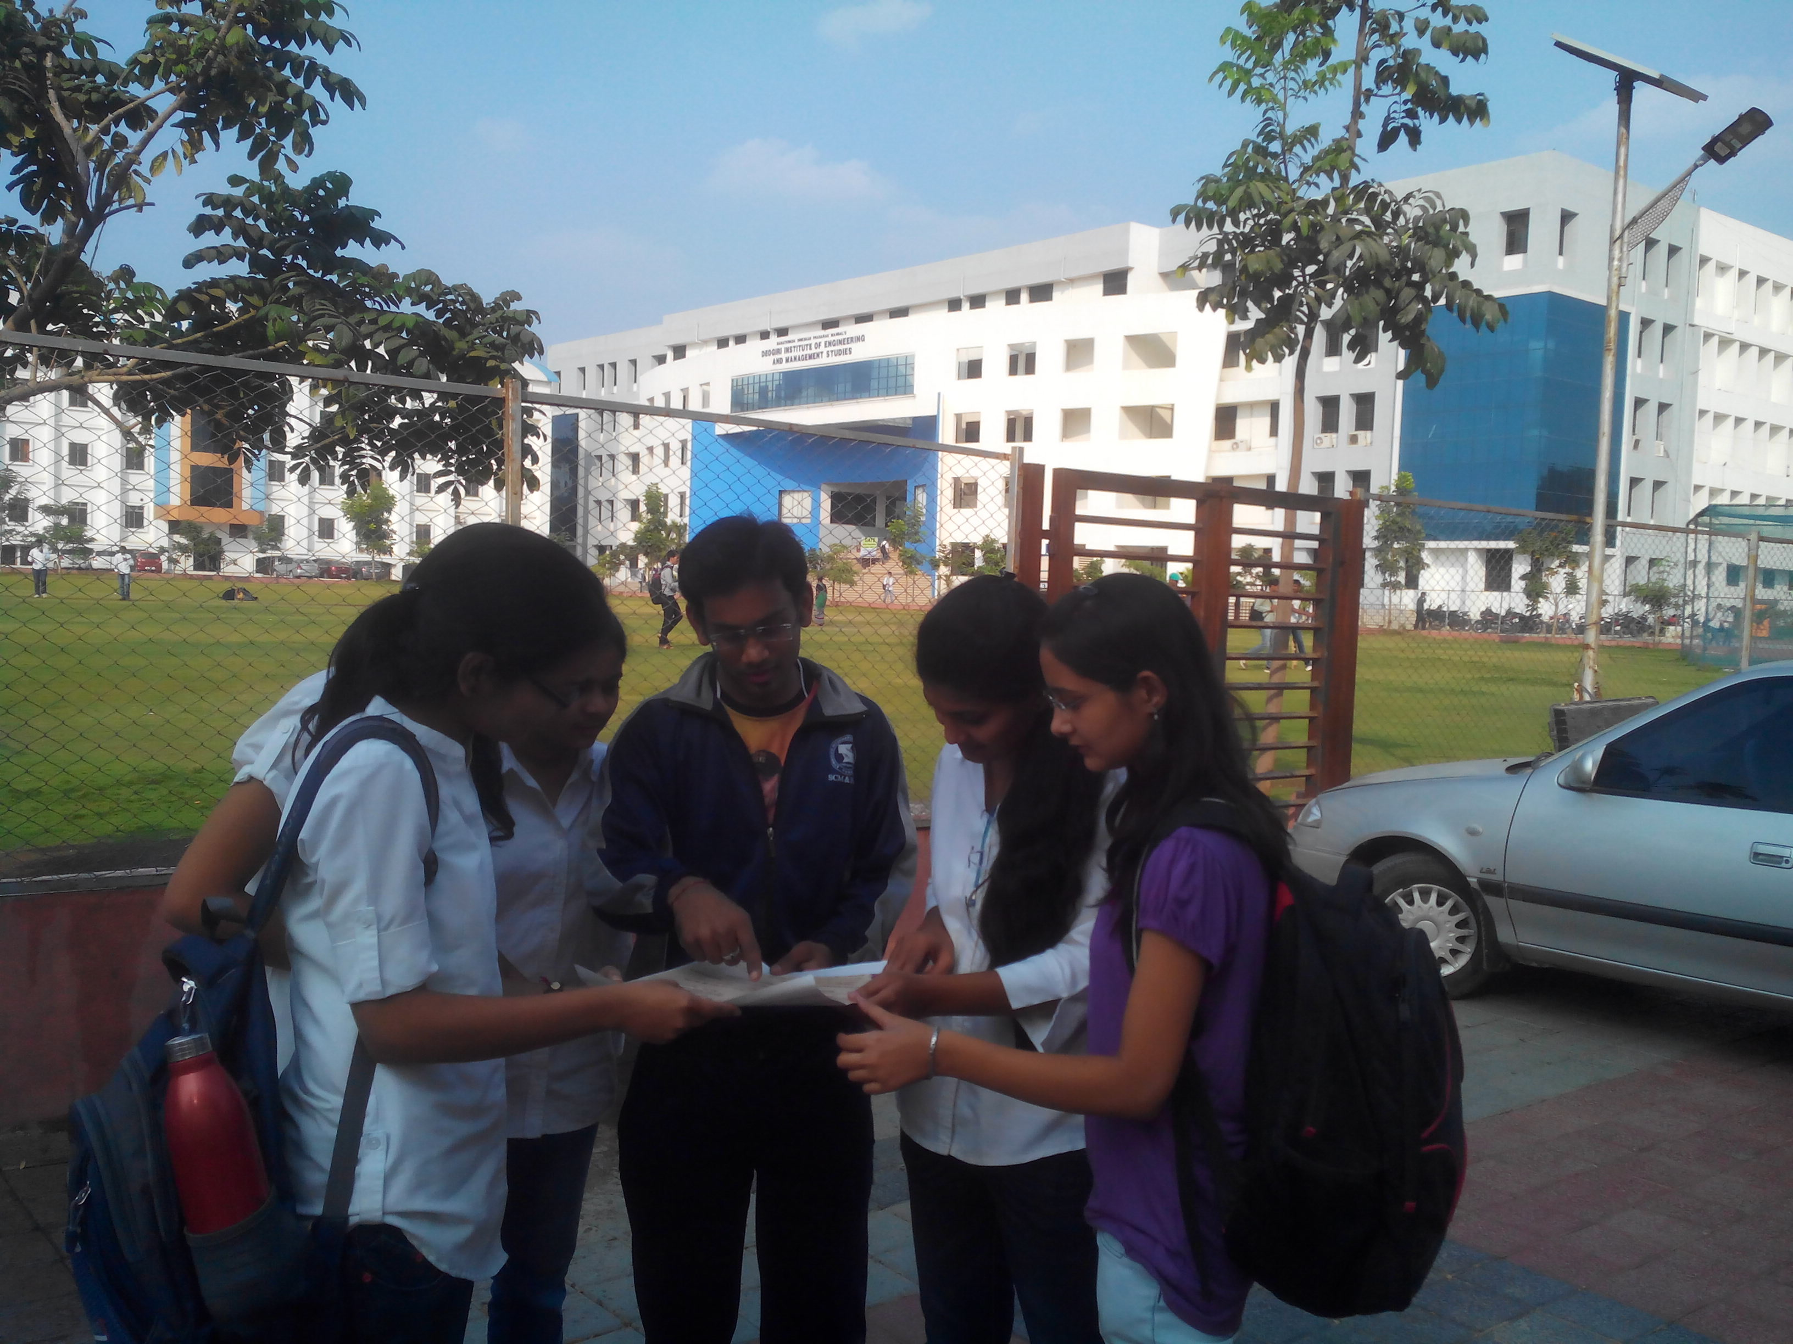
5.Support from Organizations Consulted Organizations which have large social contacts to boost the campaign of awareness. Like A. Rotract Club B. Hasya Club C. Garware Community Centre
(Hasya Club) (Rotract Club)

Slide 12
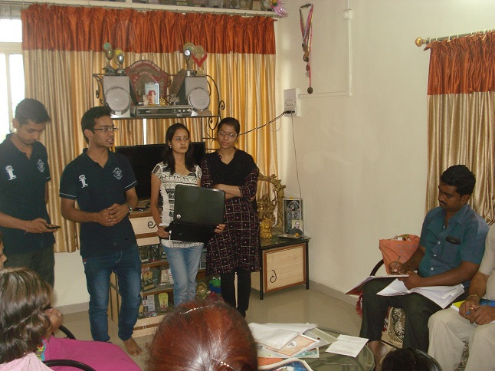
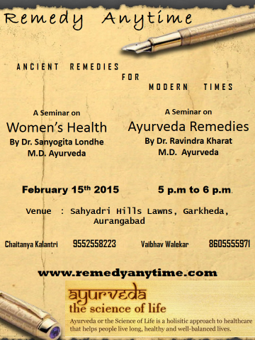
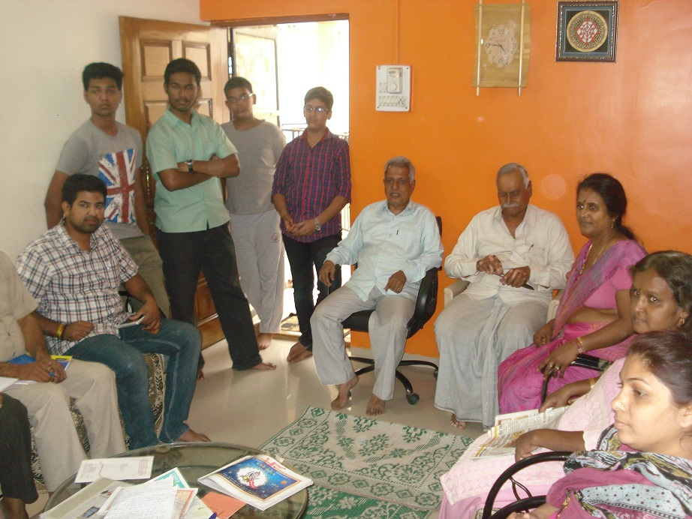
6.Seminar (Ancient Remedies for Modern Time…) Organized a seminar on 15th Feb. Aware people through Direct Interaction

Slide 13
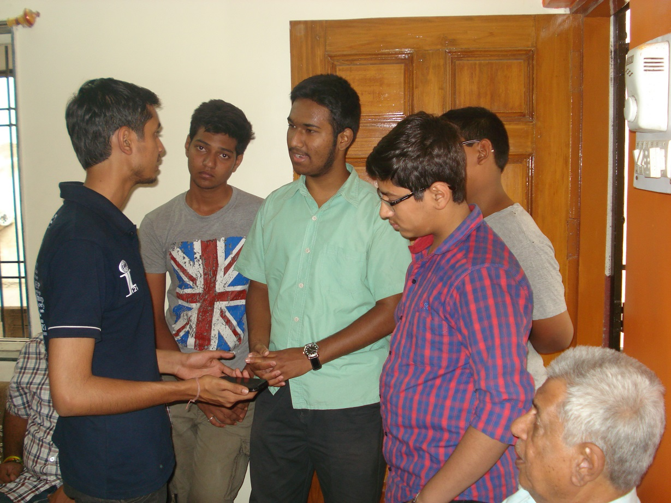
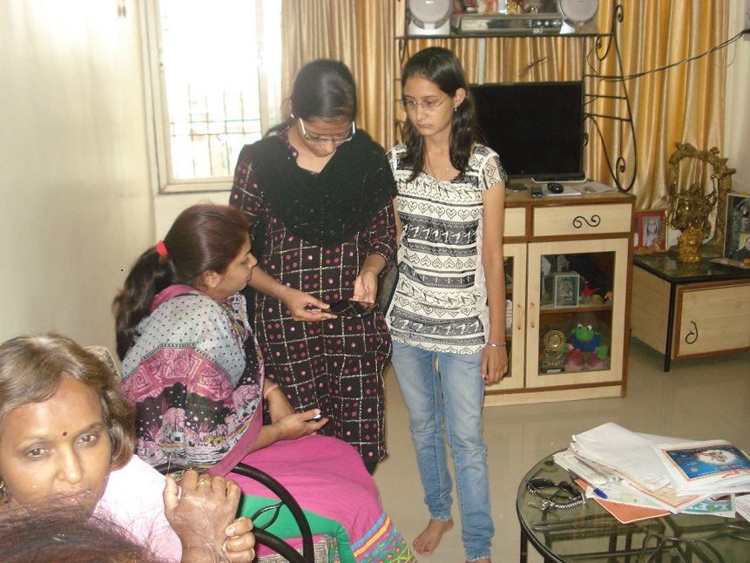
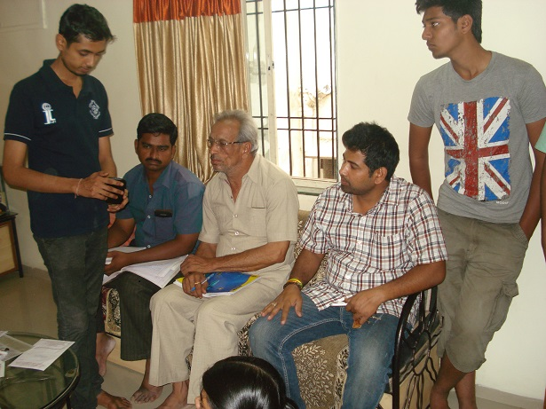
More snaps from the Seminar……..

Slide 14
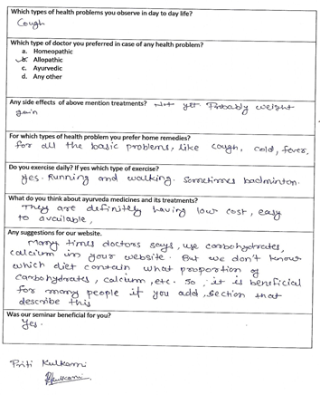
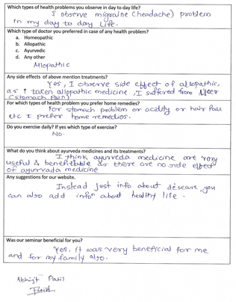
7. Survey Small Survey taken at 15th Feb Seminar

Slide 15
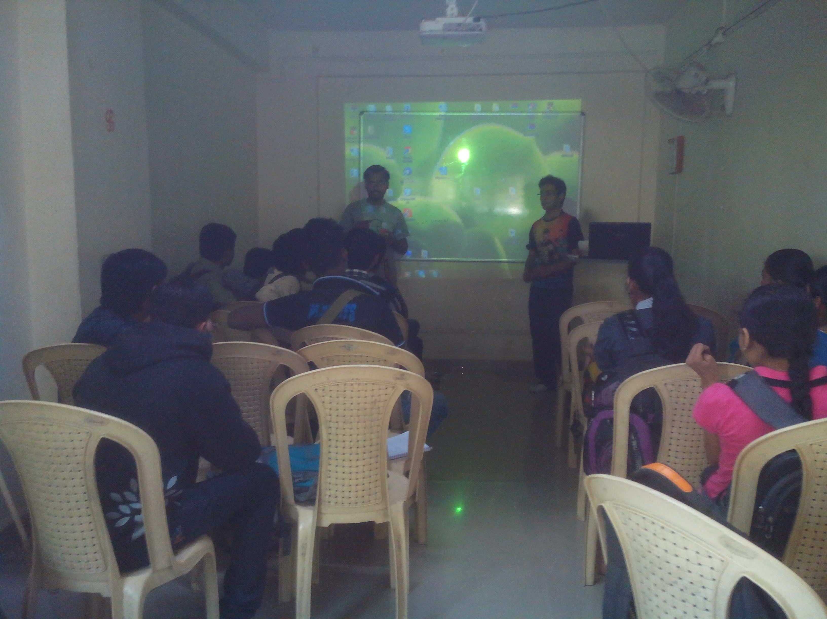
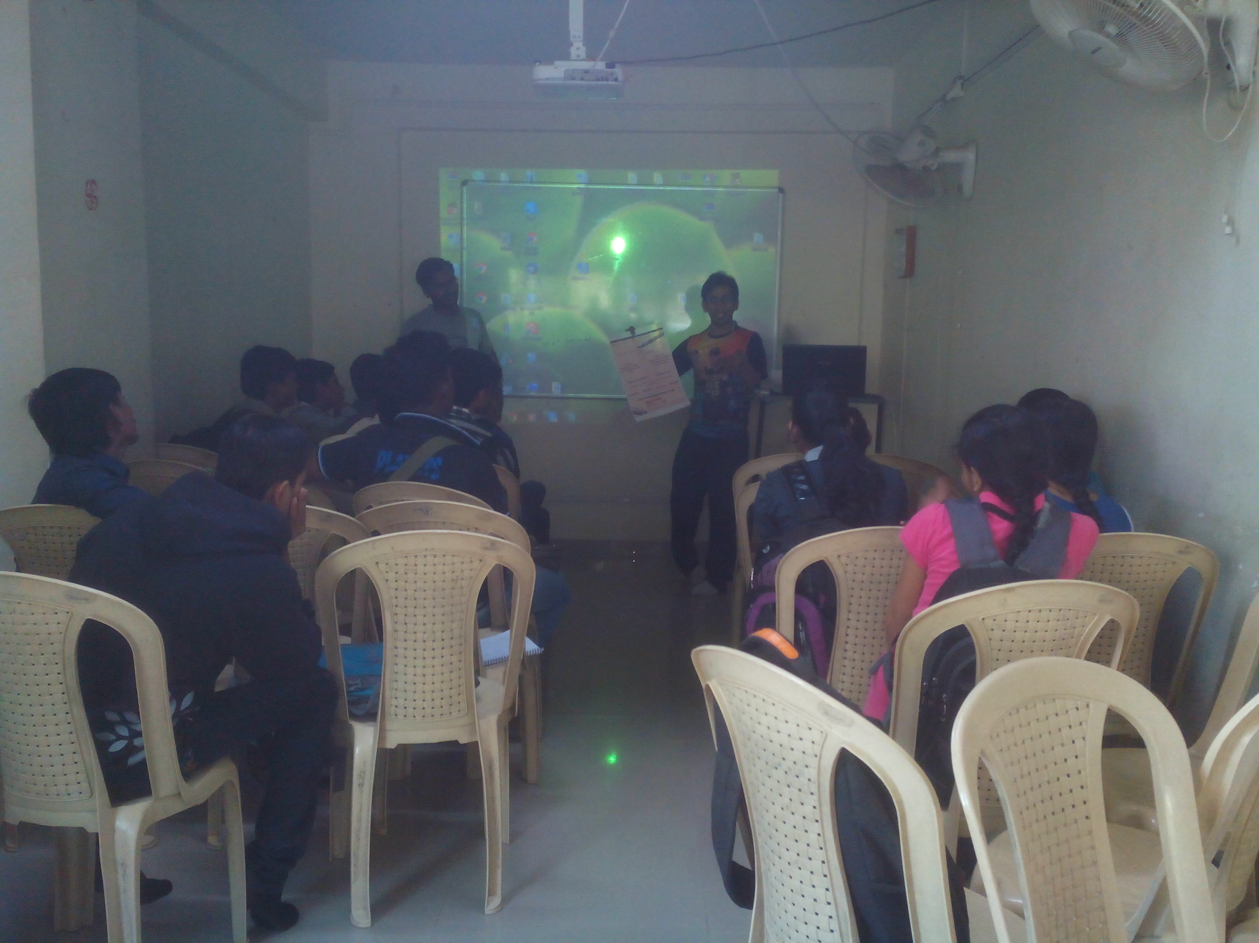
8.Small Seminar Organized a seminar at Giri’s Educom. Make awareness about Yoga and Tips for healthy life

Slide 16
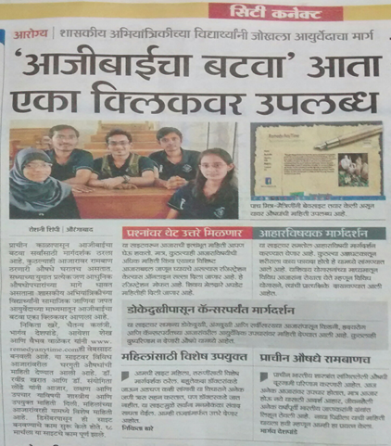
9.Support from Media Newspaper is a strong medium to create awareness. Support from Media 1. Divya Marathi Newspaper 2. Maharashtra Times Newspaper 3. Times Of India Newspaper

Slide 17
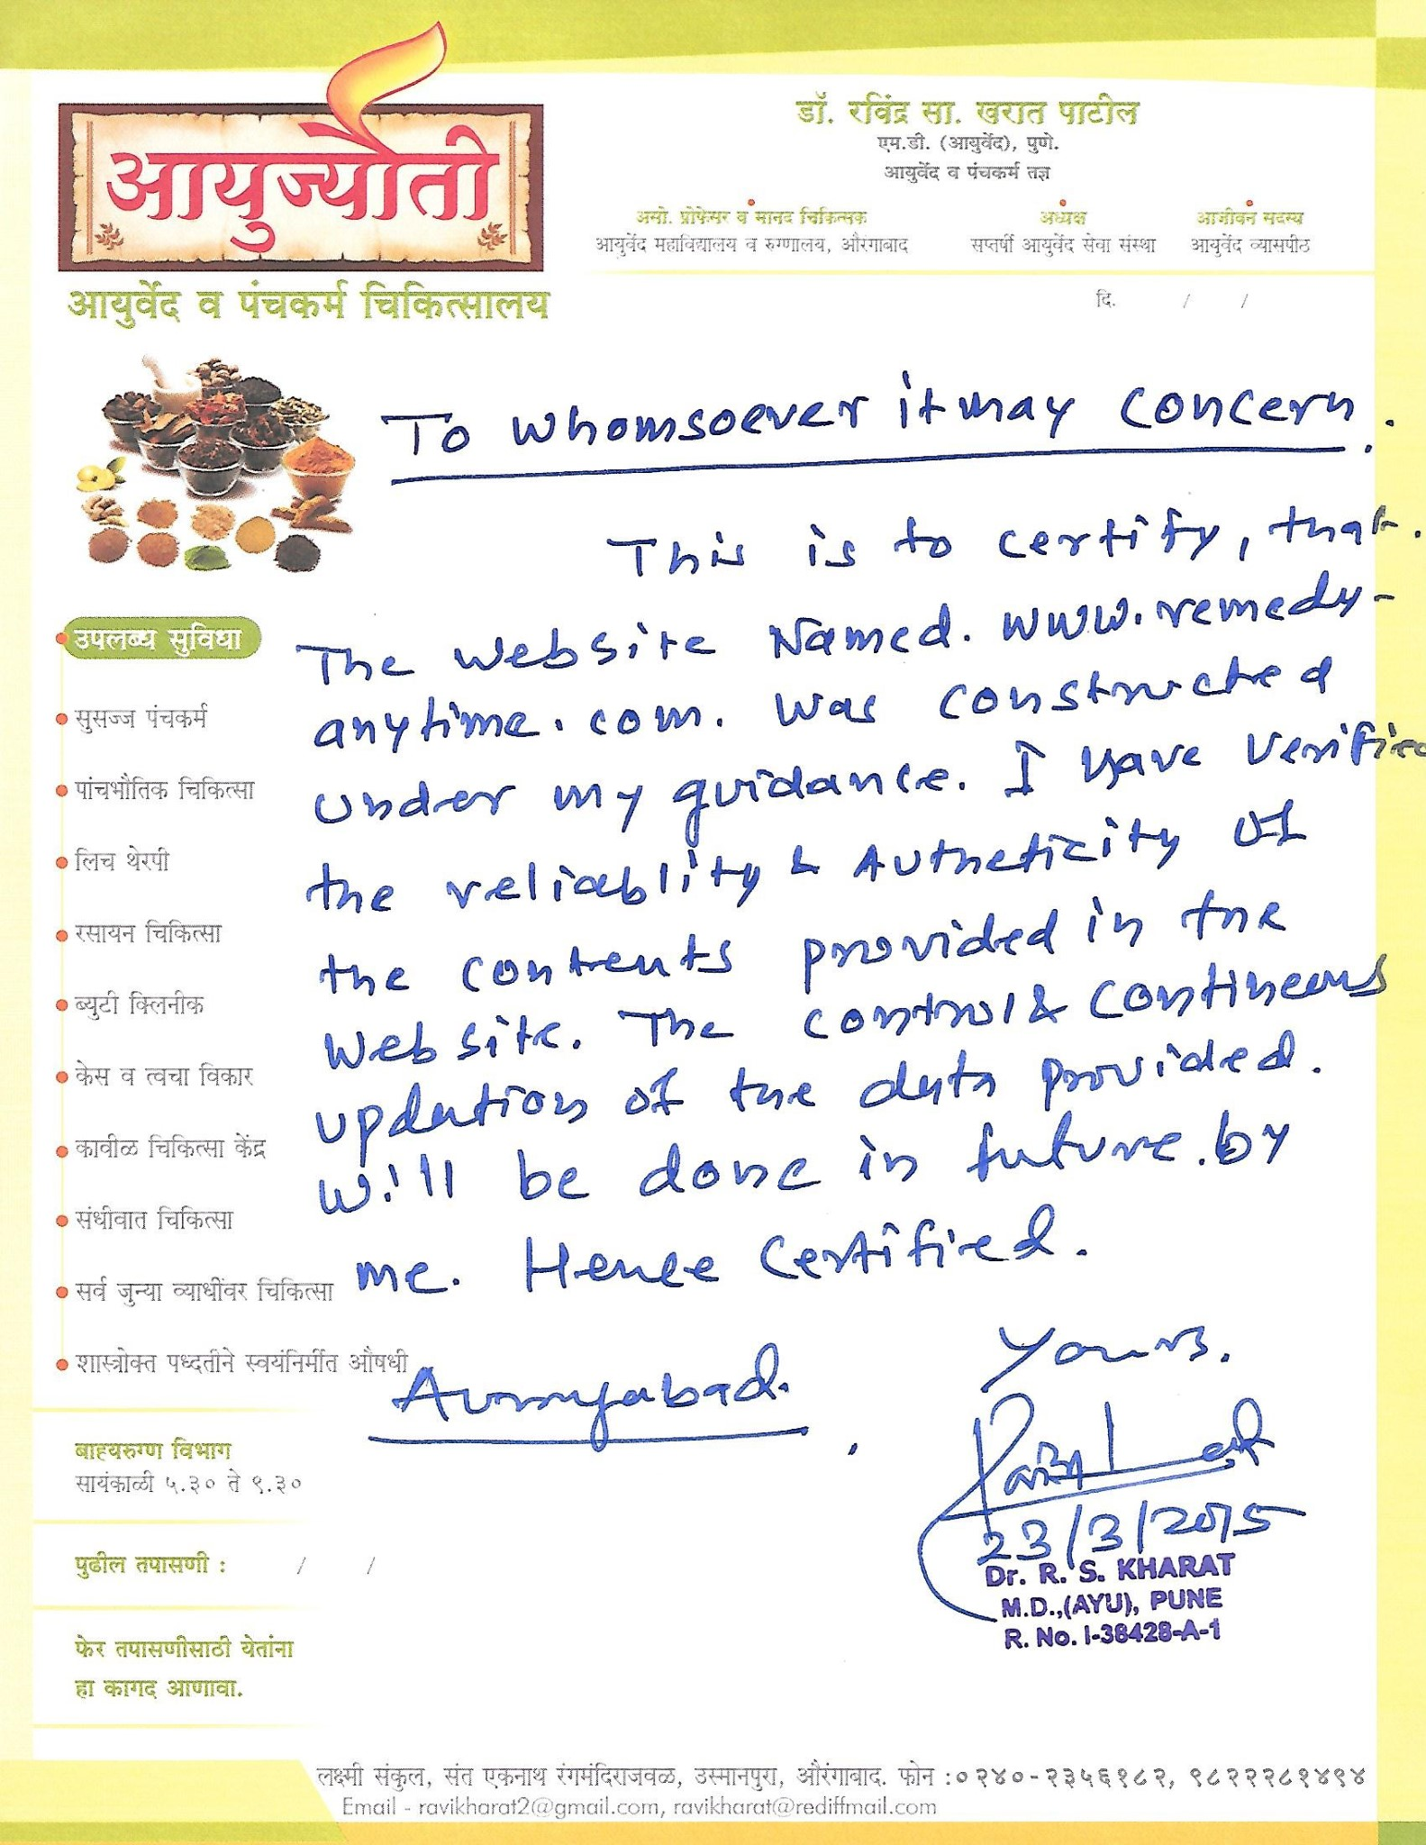
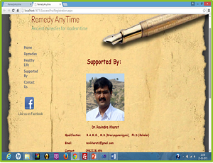
Sustainability: 1. Through Offline Android App. It can be shared easily at faster rate and doesn’t require internet. 2. Guidance from Dr. Ravindra Kharat. He assured us to control and modify our website further. 3. Last but not the least, the amount of efforts we have put in for this project will always enthusiast us to improve this project to a higher and higher level.

Slide 18
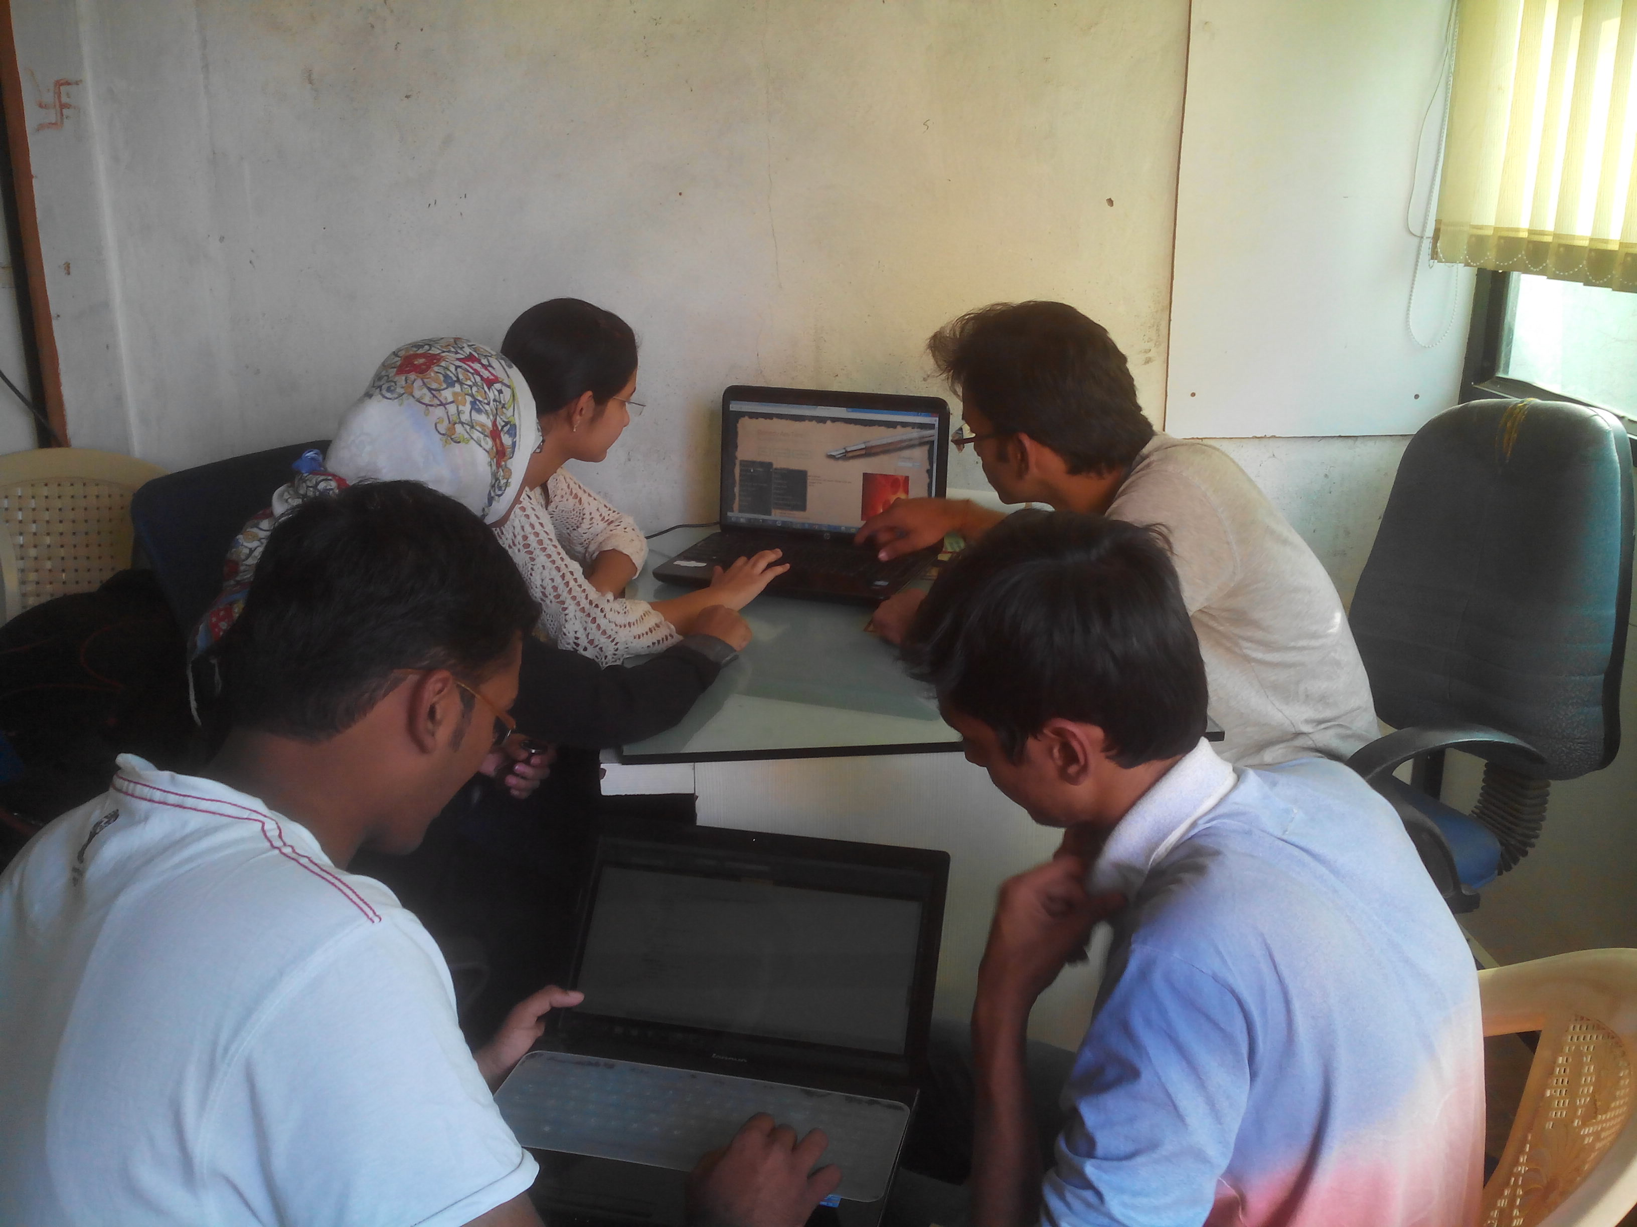

I2I Impact:
Our team is thankful to I2I for providing us this opportunity for exploring the hidden talents that we had:
1. During information gathering, we gained knowledge about home-made remedies for many diseases.
2. We learned how to work in a team as a single unit and
how to cooperate with each other for the benefit of
the group/project as a whole.
3. We learned how to organize and manage small seminars and this will surely help us in applying the same
principles for larger ones.
4. While promoting about our seminars, we learned how to communicate and handle variety of different questions
coming from a lot of people.

Slide 19
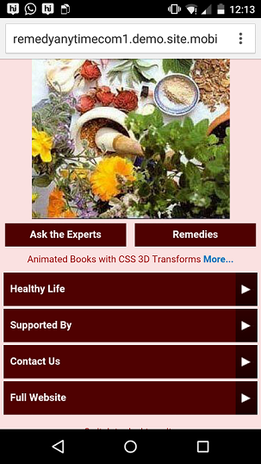
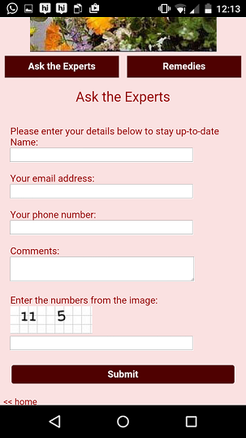
Things to be improved: 1. The website layout is not mobile friendly. But, we have created its mobile friendly version by name “ http://remedyanytimecom1.demo.site.mobi/” 2. Registration Page is under construction. But, one can ask problems to expert Doctor through the link shown above.

Slide 20
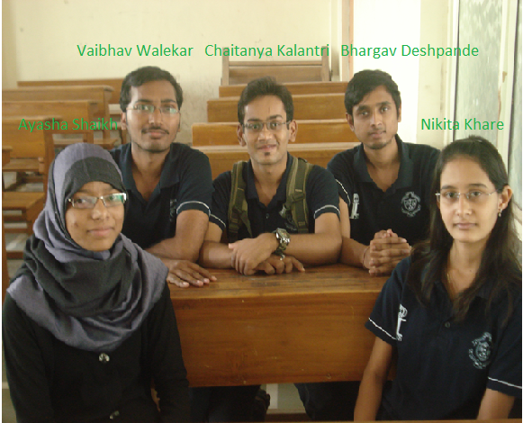
Team Members: Thank you I2I, For giving us a golden opportunity to explore our talent…

Slide 21

Dream India Disease-Free…

